Slide 1
Using a Raspberry Pi to automate our brewery
06/08/18 4:00PM EST

Slide 2

Nathan Weber
Head of Maintenance
Burial Beer Company

Slide 3
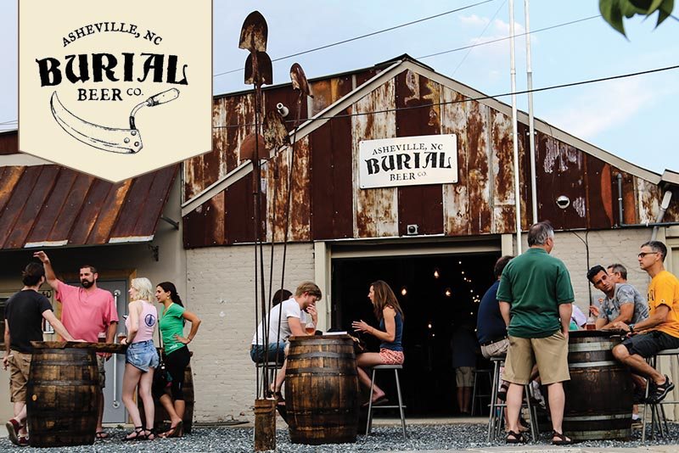

Slide 4
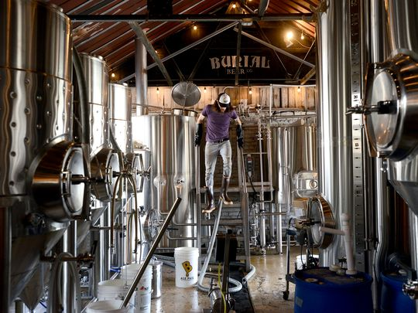

Slide 5
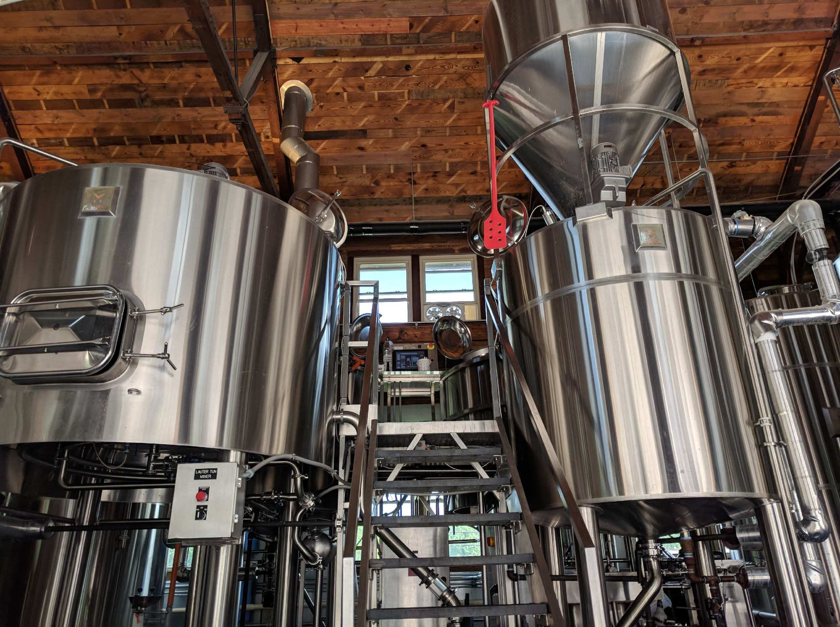

Slide 6
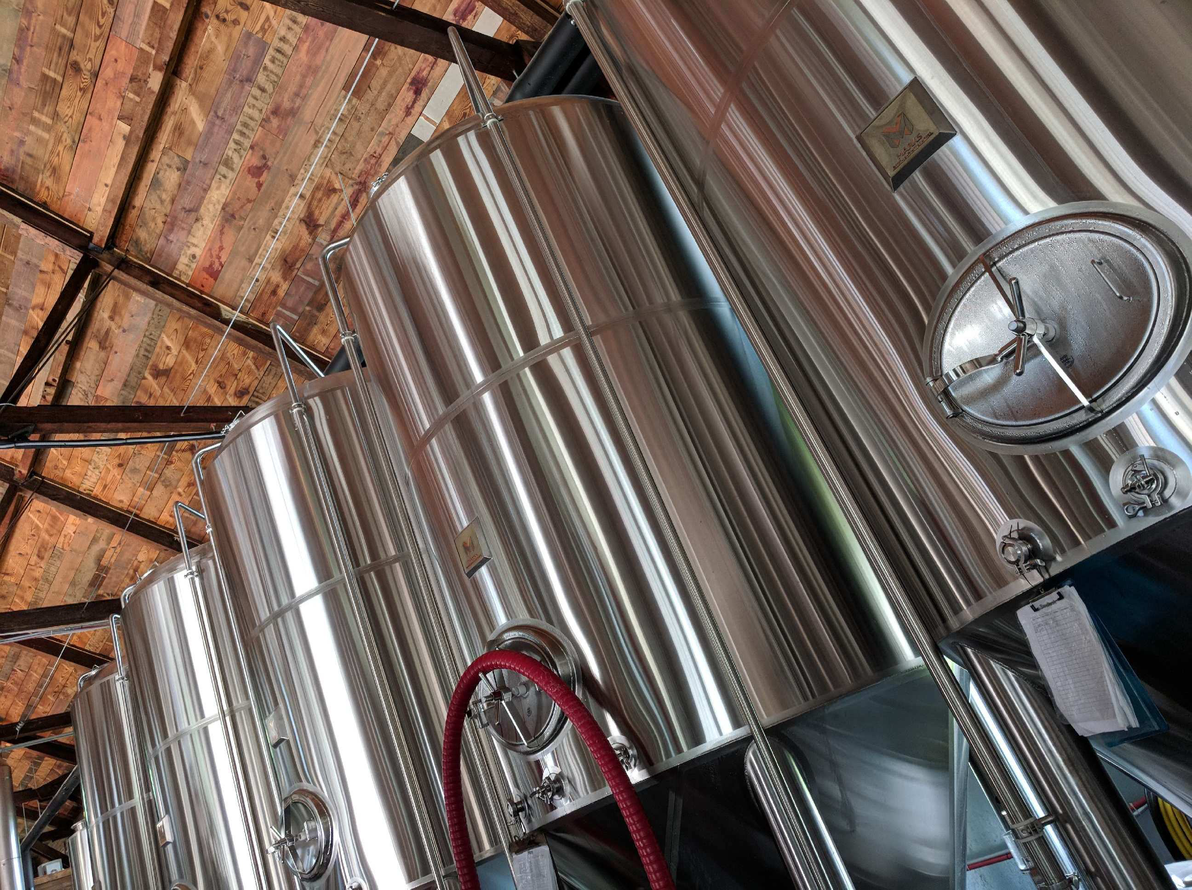

Slide 7
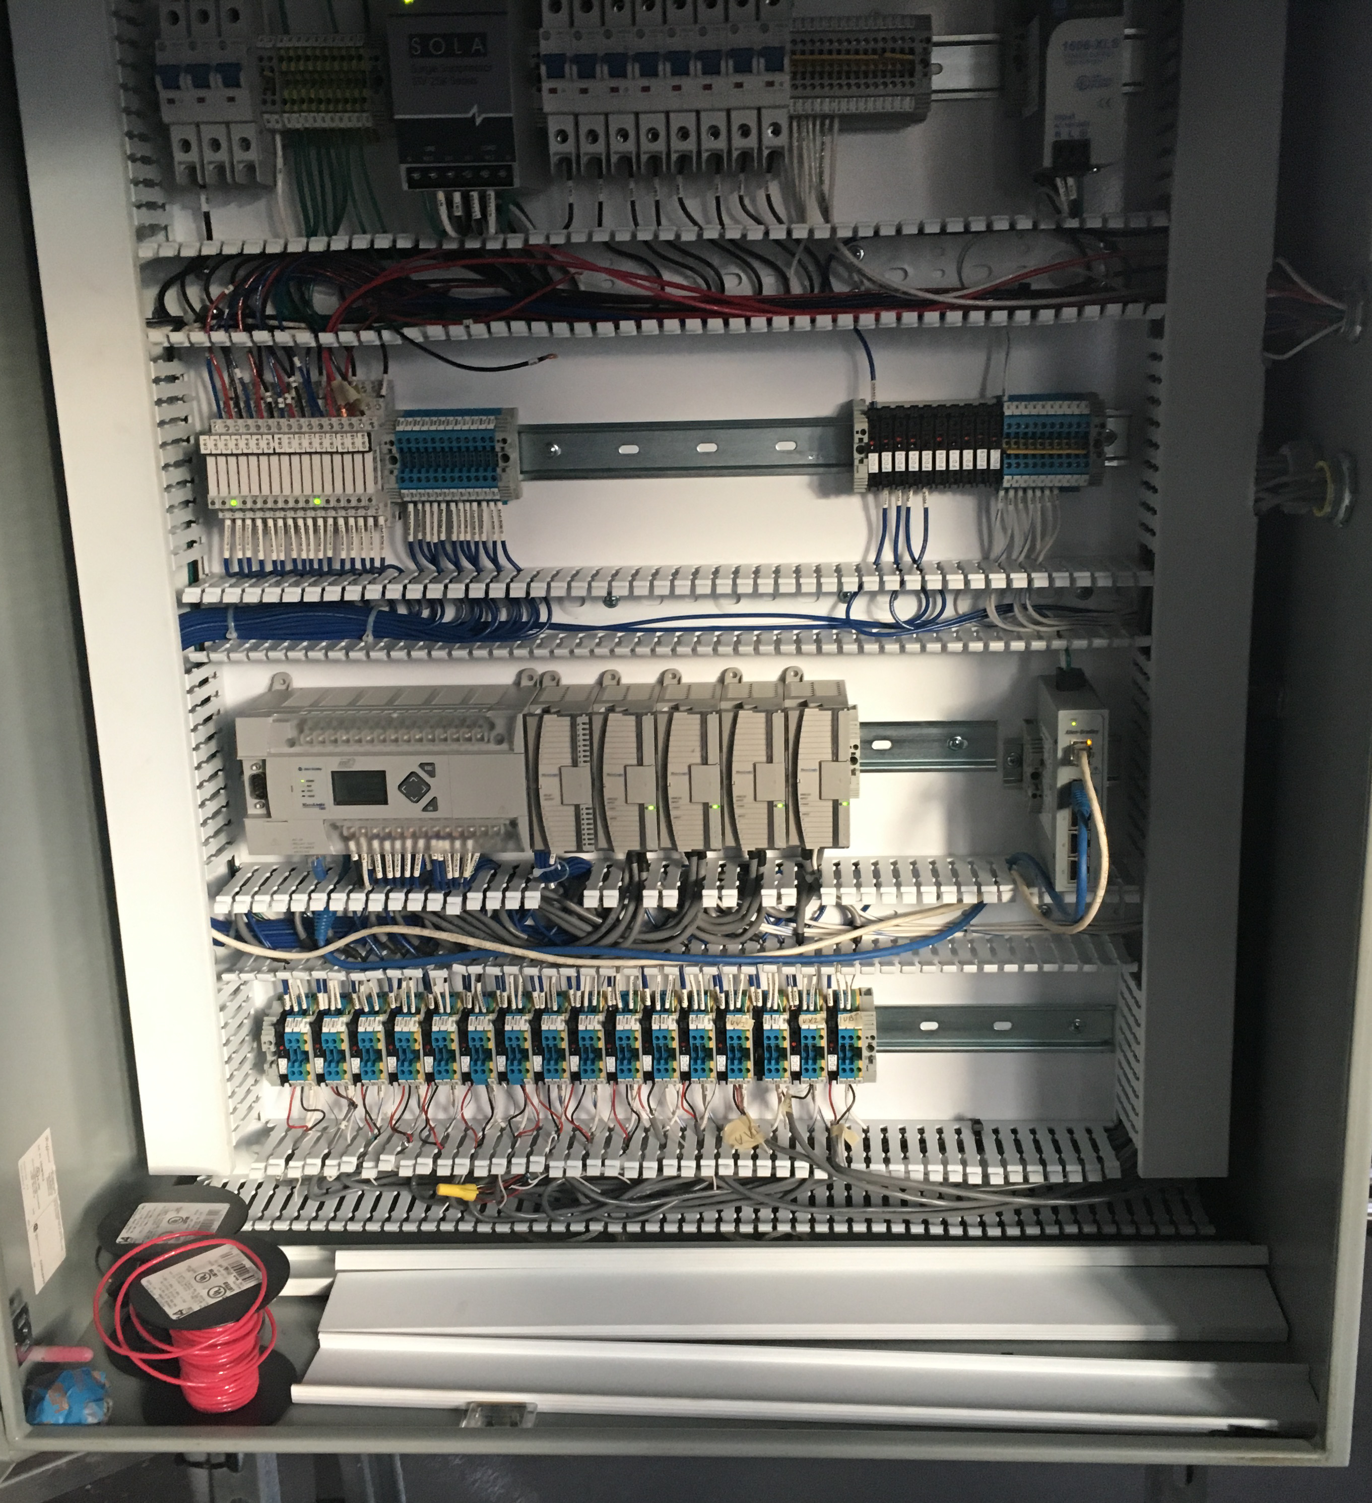
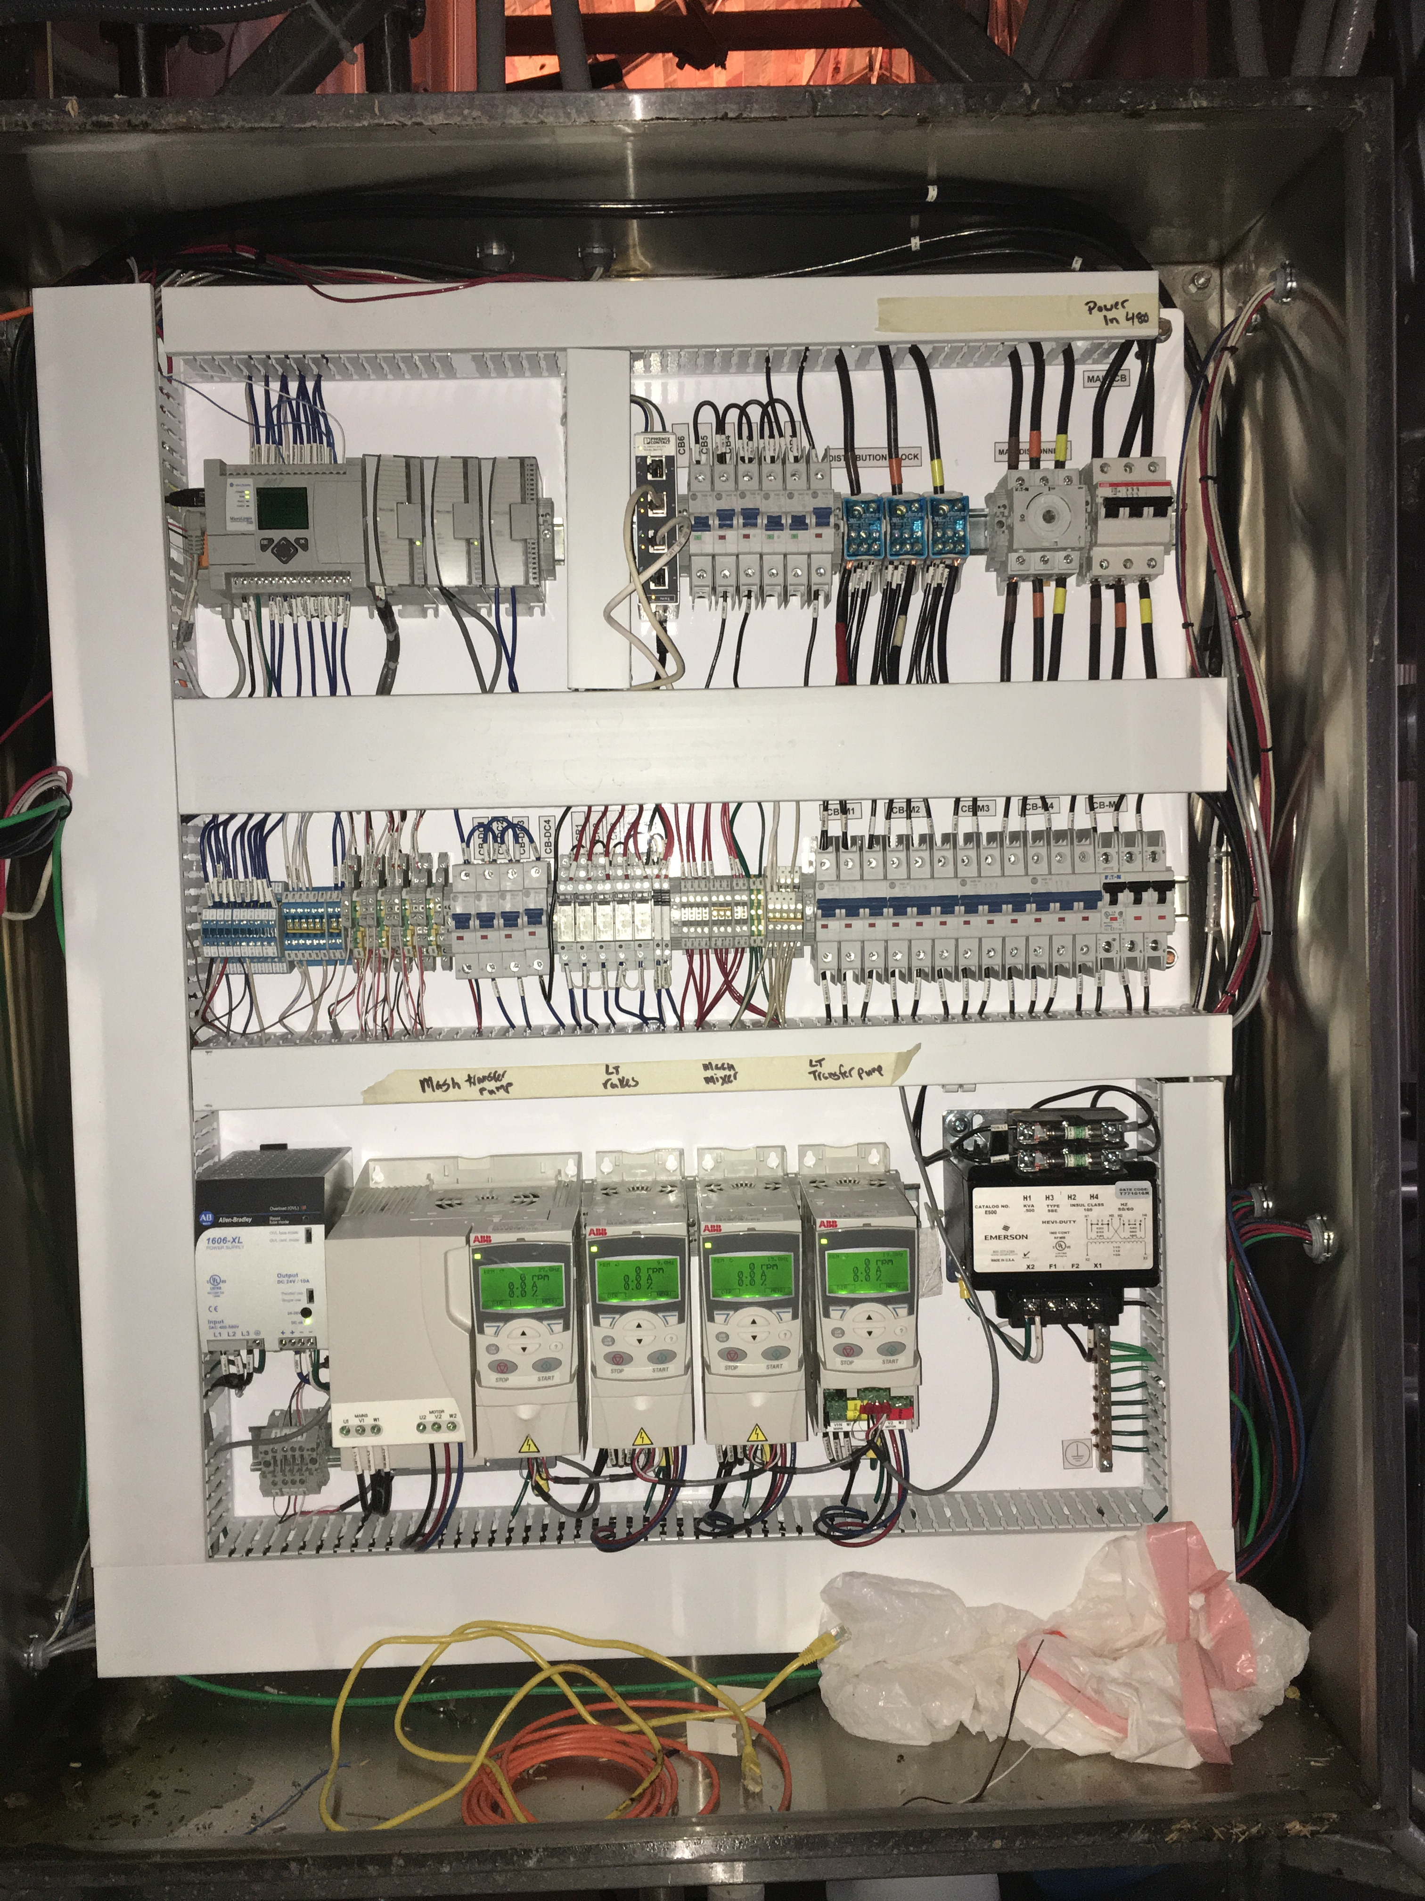

Slide 8
Then Tragedy Struck

Slide 9
“If the tool’s not right, the guy’s not bright”
-William Charles Hess

Slide 10
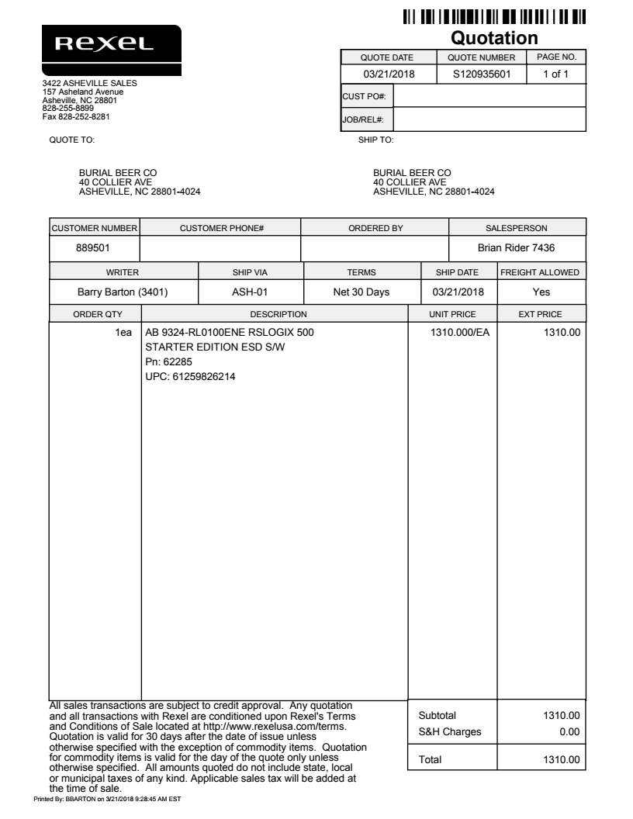
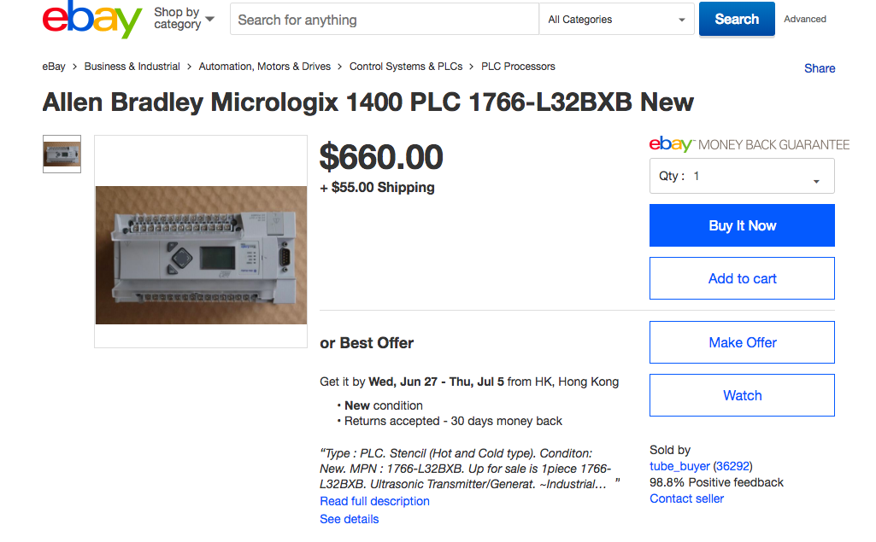

Slide 12








FOSS in my life

Slide 13
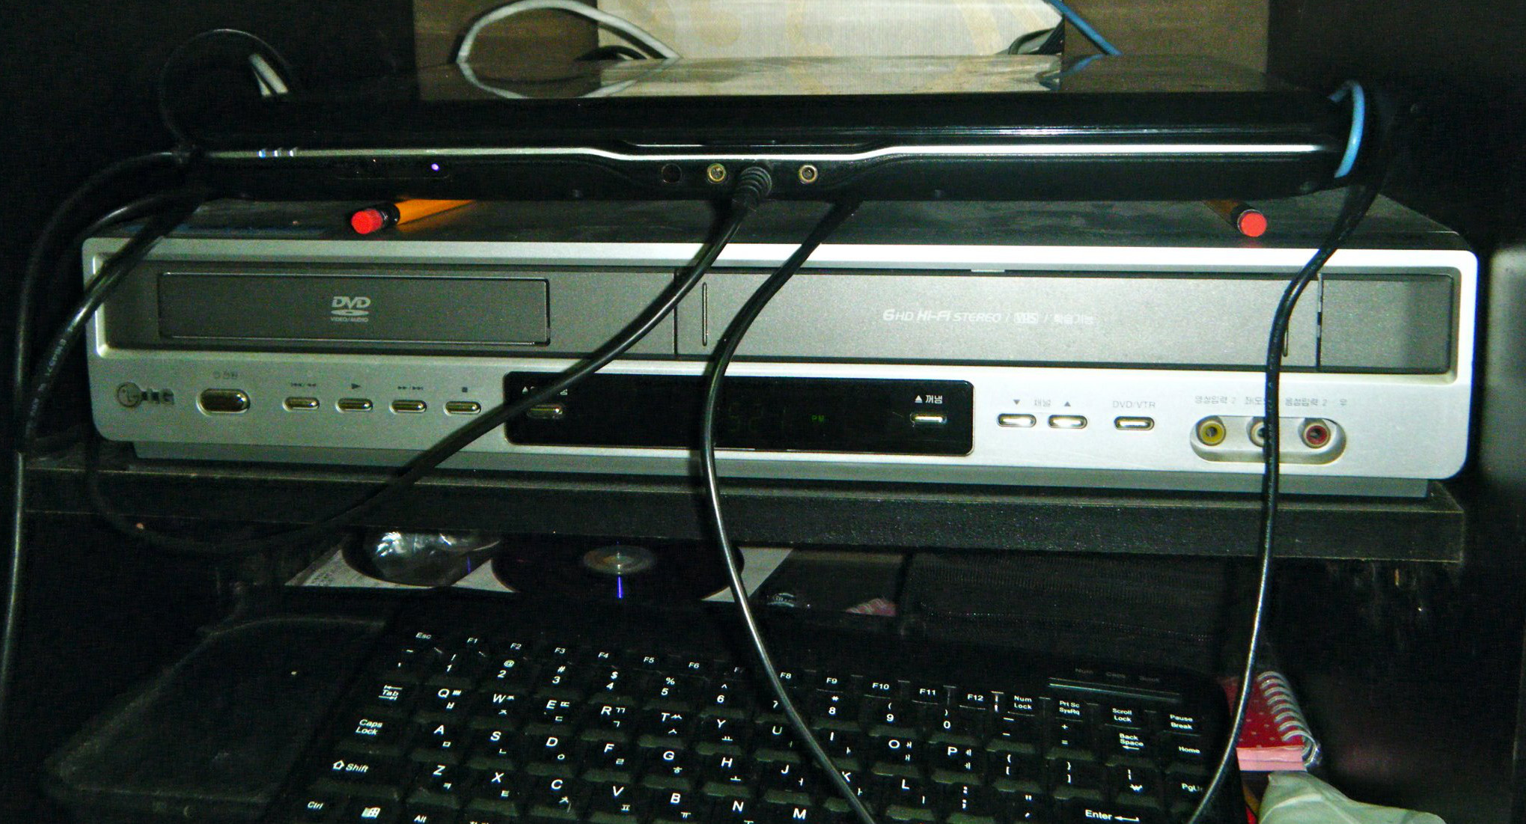
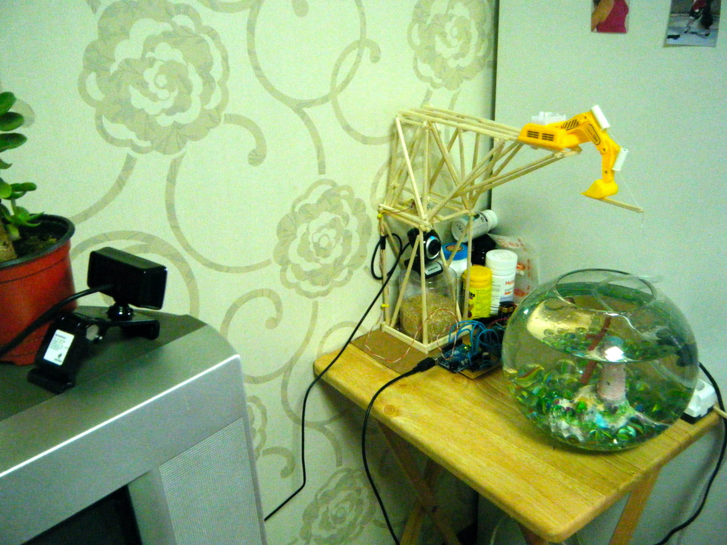
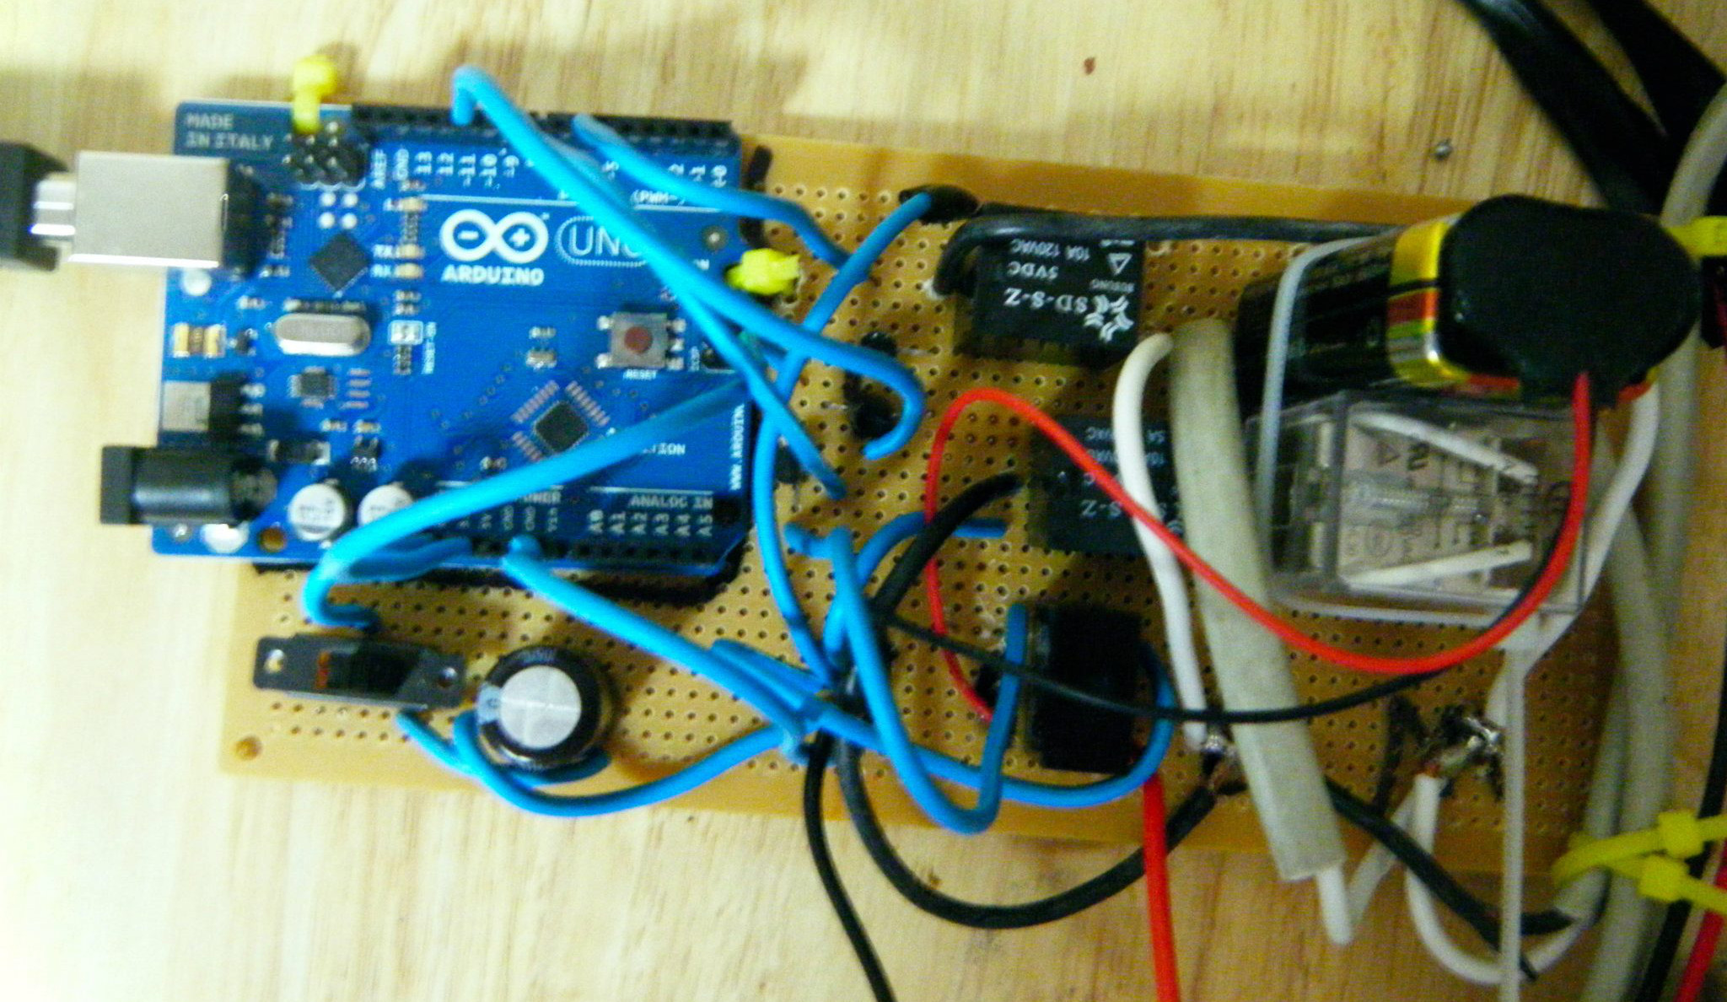
A solution all started with a fish

Slide 14
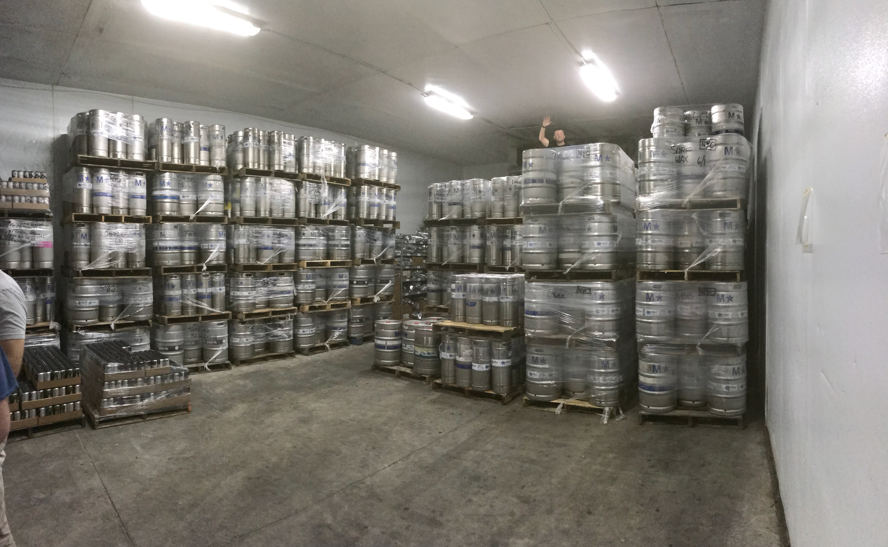
And then it made it’s way into the cooler

Slide 15
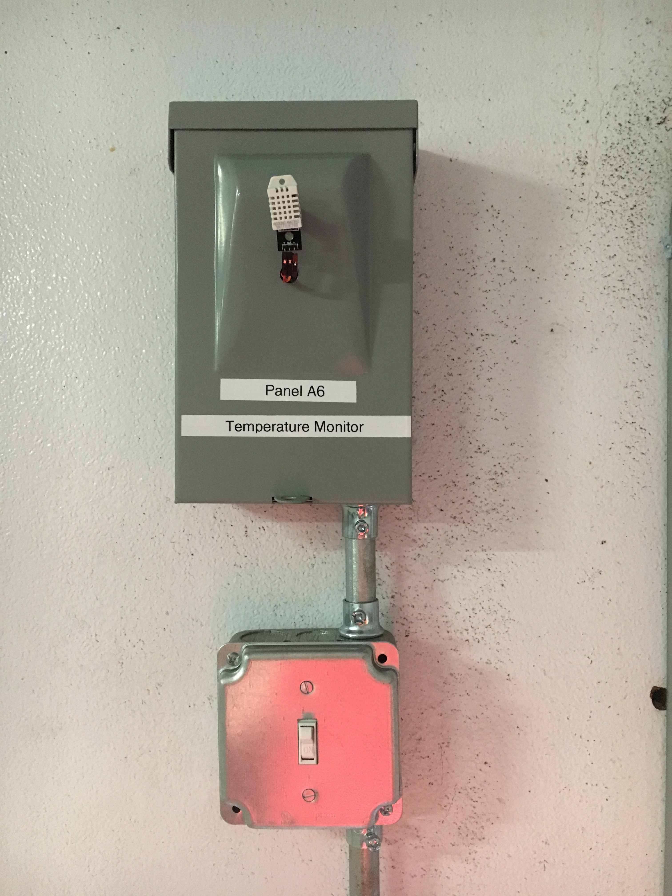
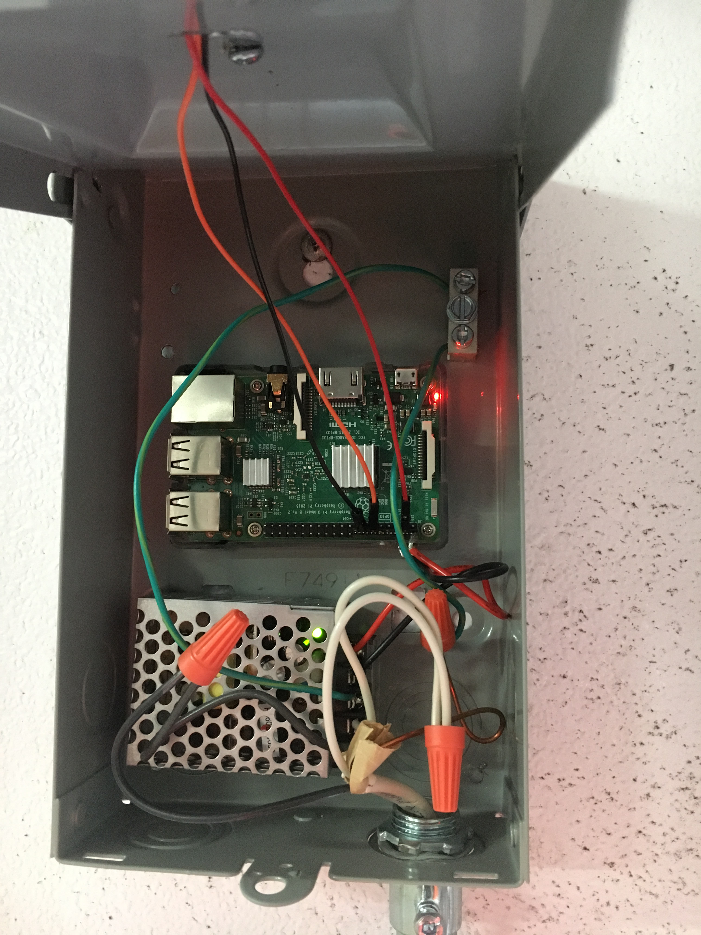

Slide 16
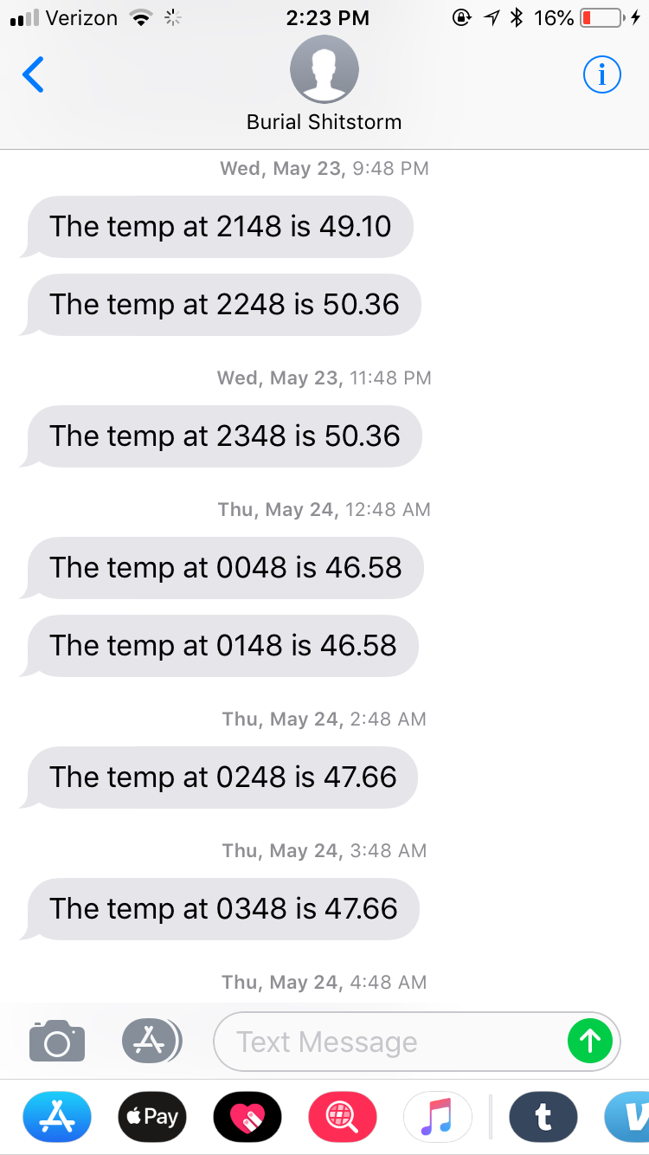
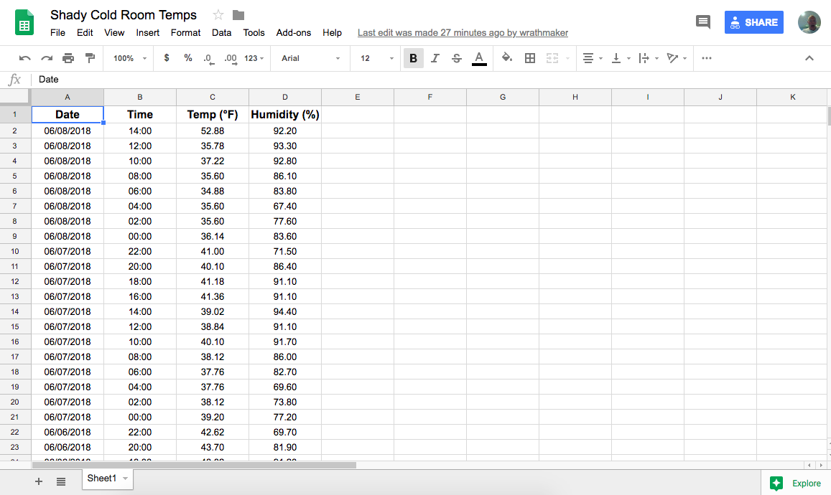

Slide 17
Hardware
Raspberry Pi 3
Mean Well RS-15-5 5V 3 Amp 15W
HiLetgo DHT-22 / AM2302
AC disconnect box from Home Depot

Slide 19
Software
RC.local > watchipin.sh
watchpin.sh > spreadsheet.py
cron > spreadsheet.py
watchpin.sh > textnathan.sh

Slide 21
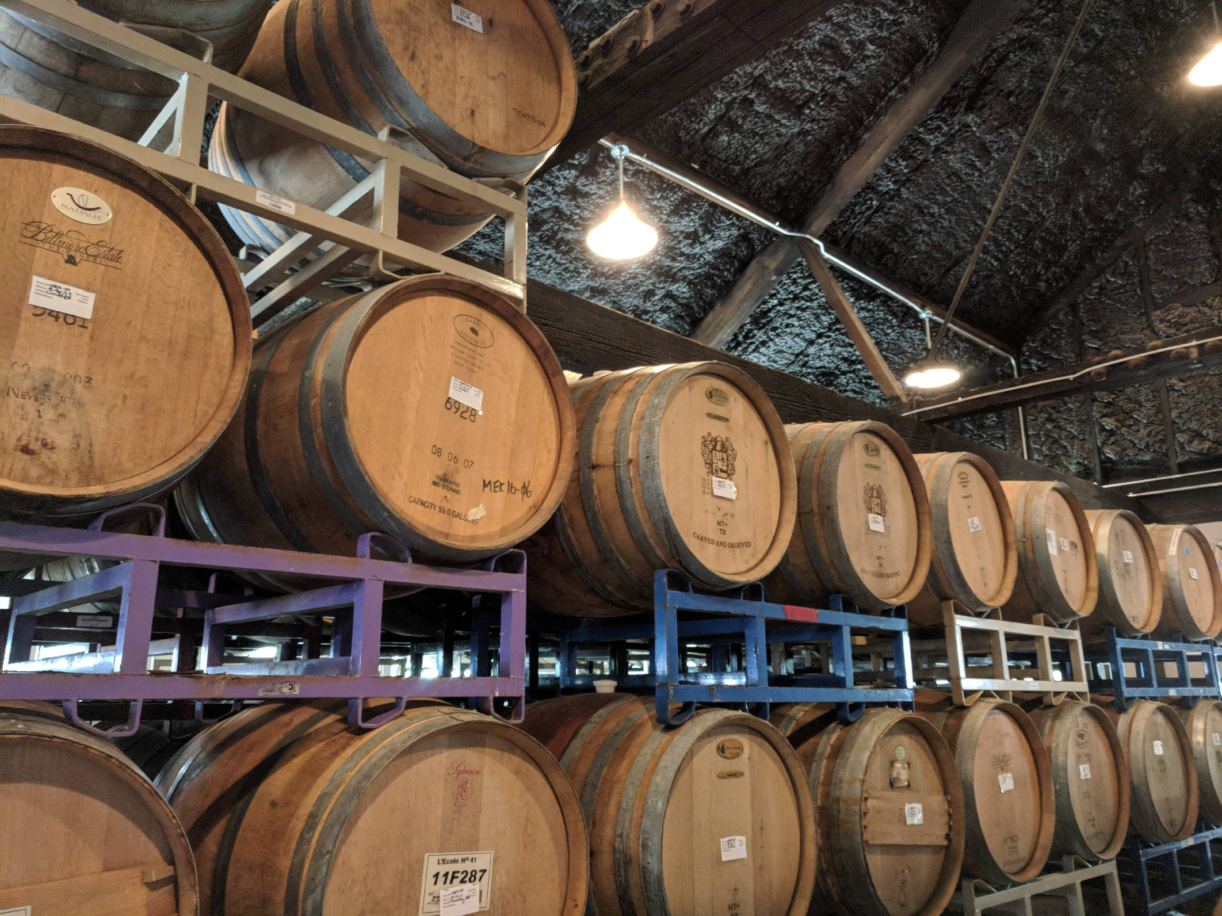
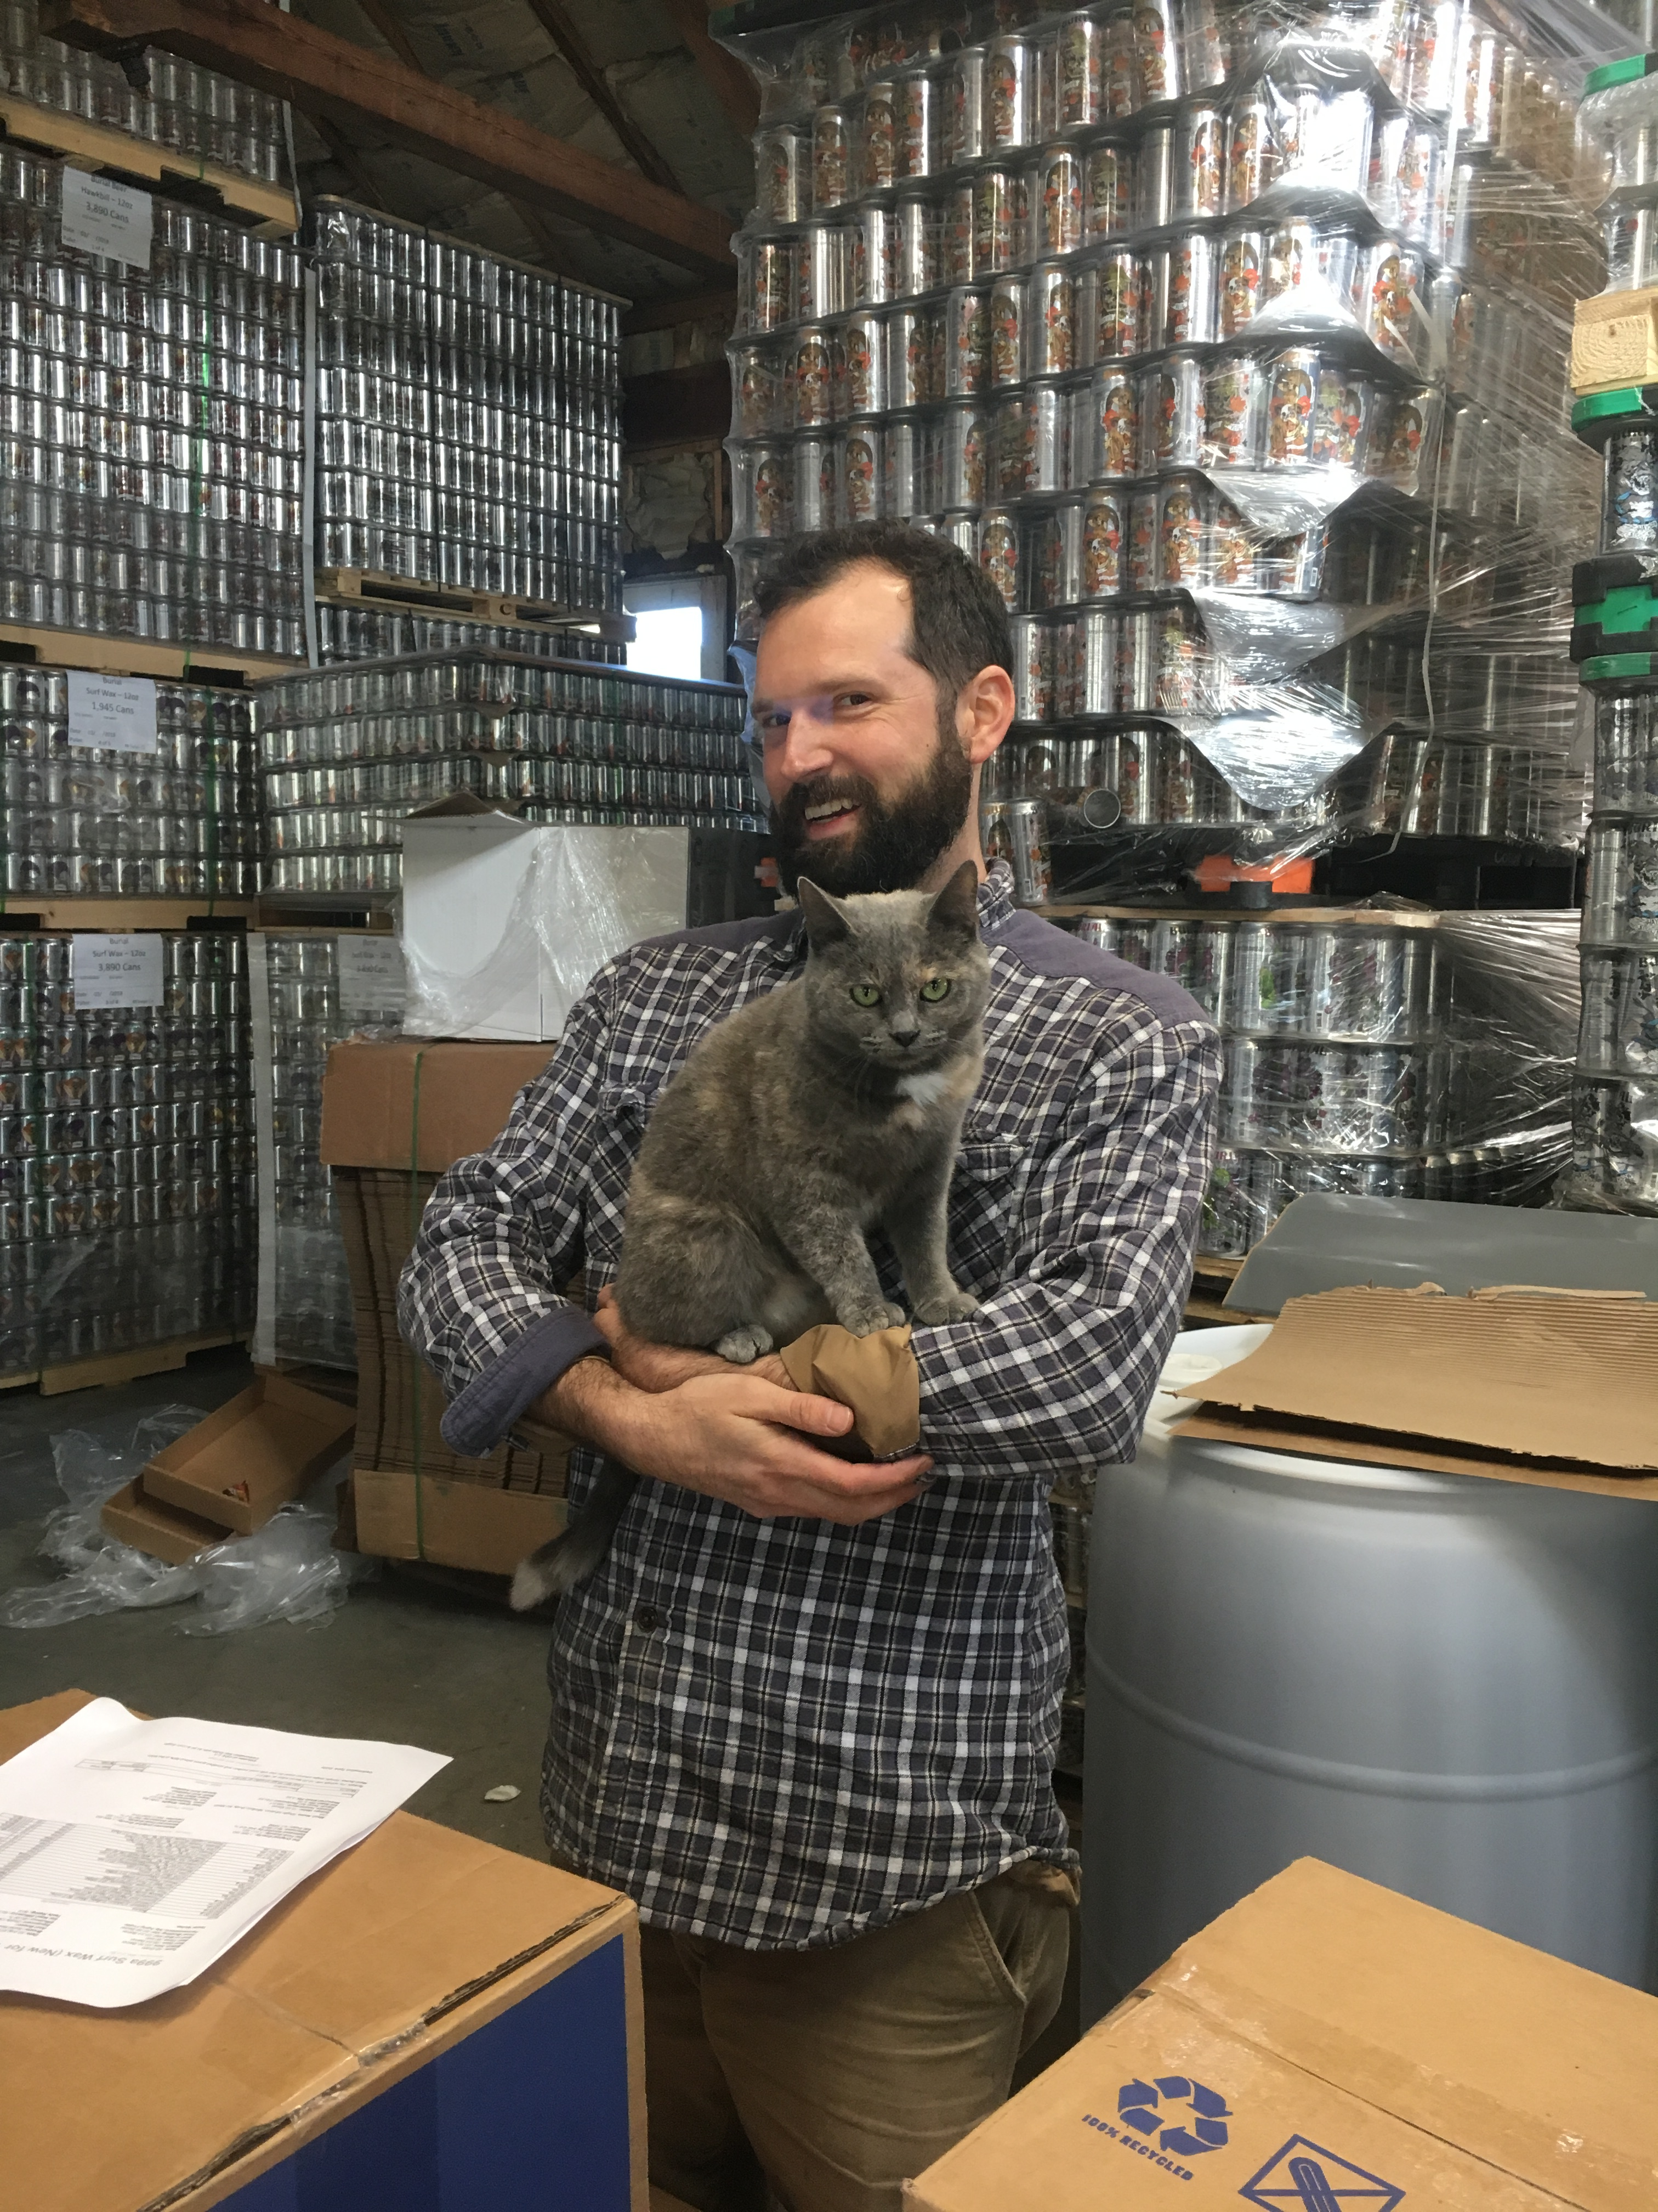
And then it made it to the Barrel House

Slide 22
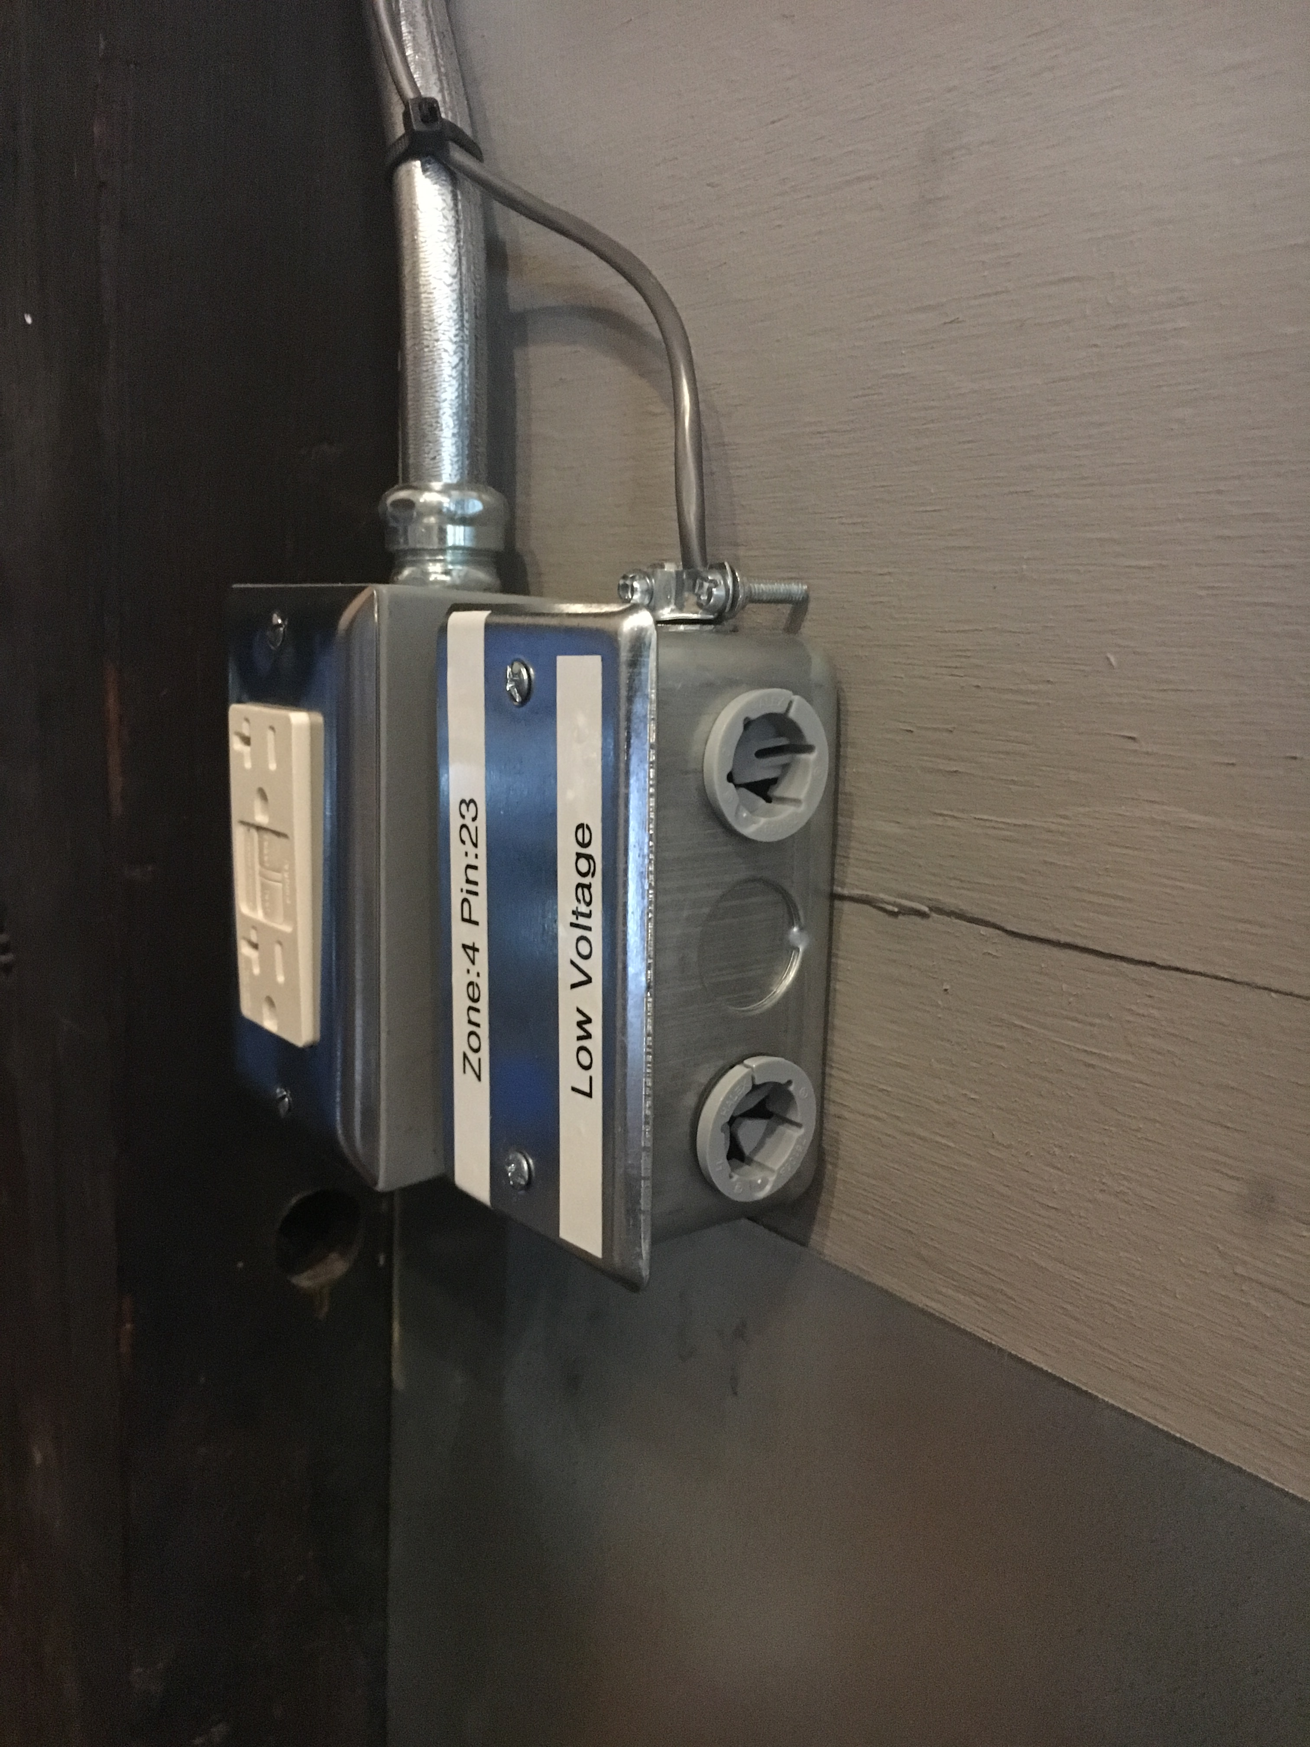
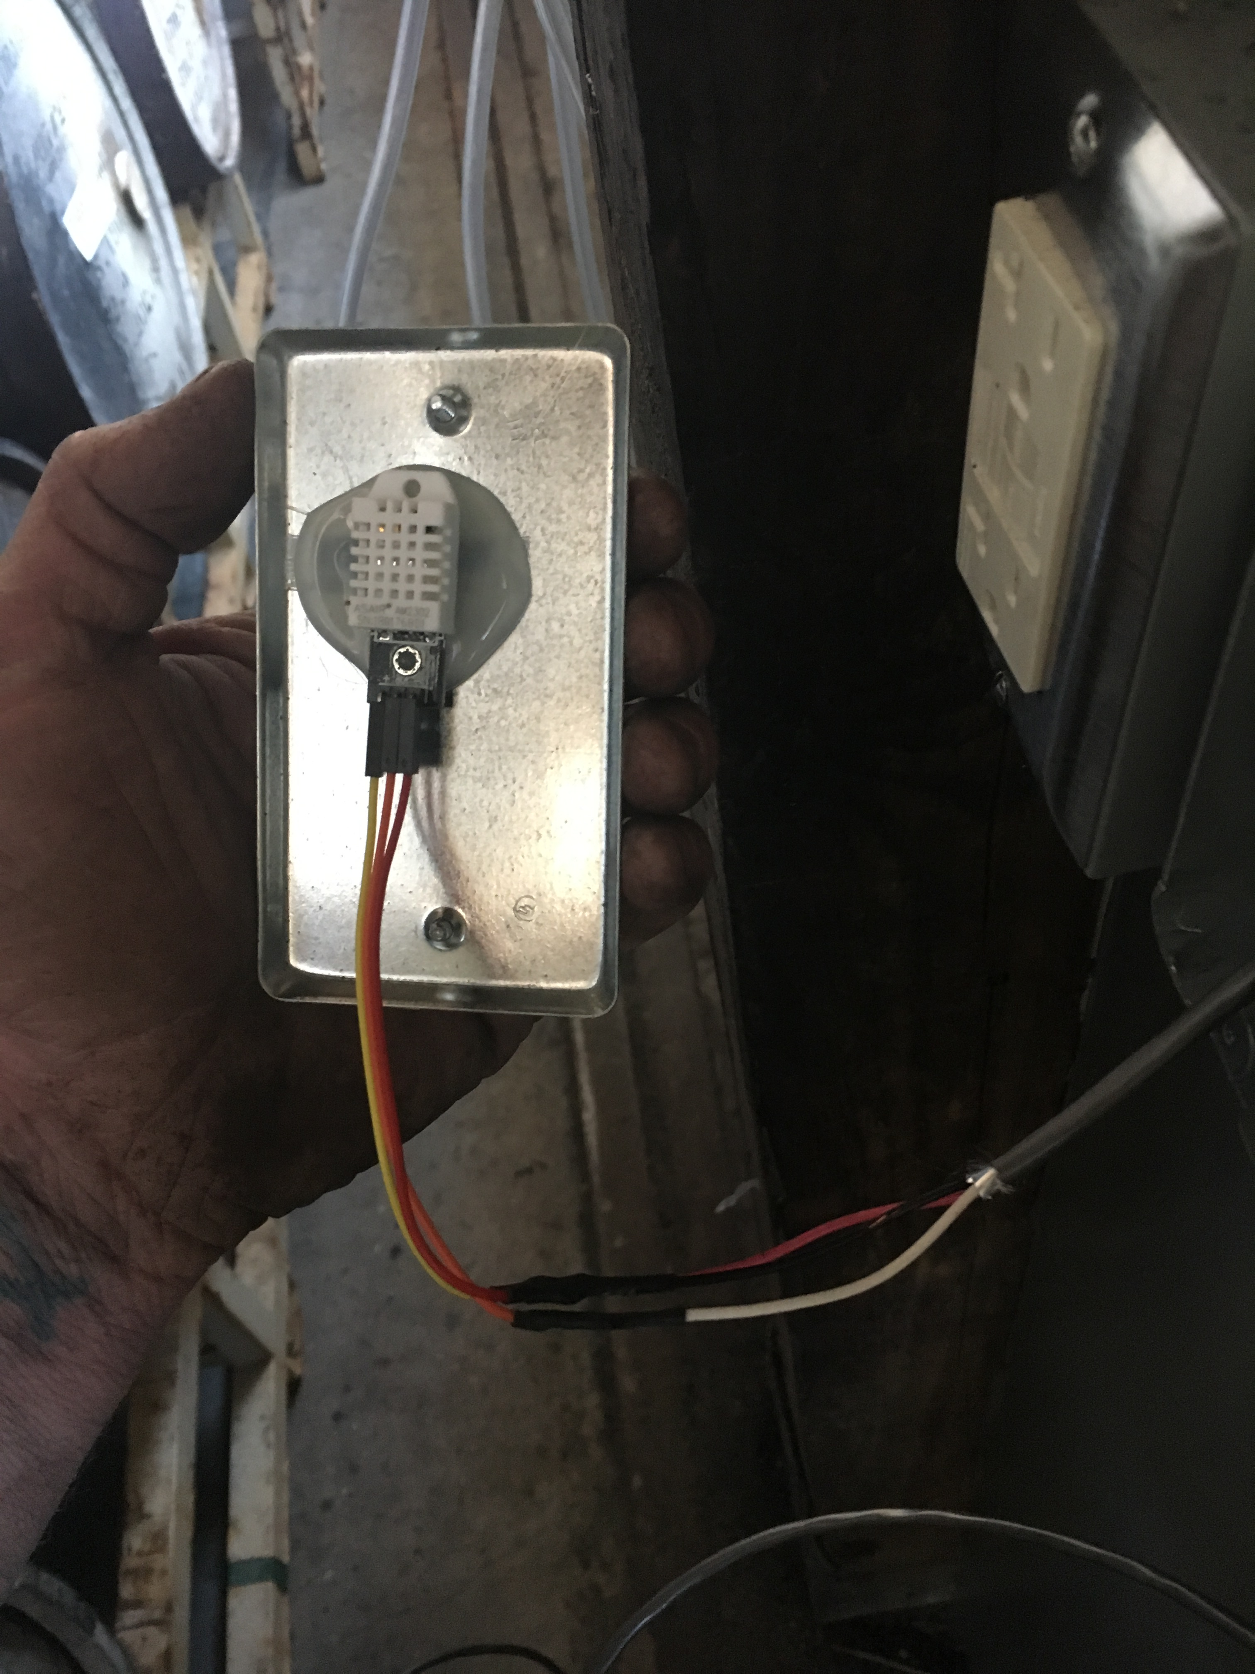
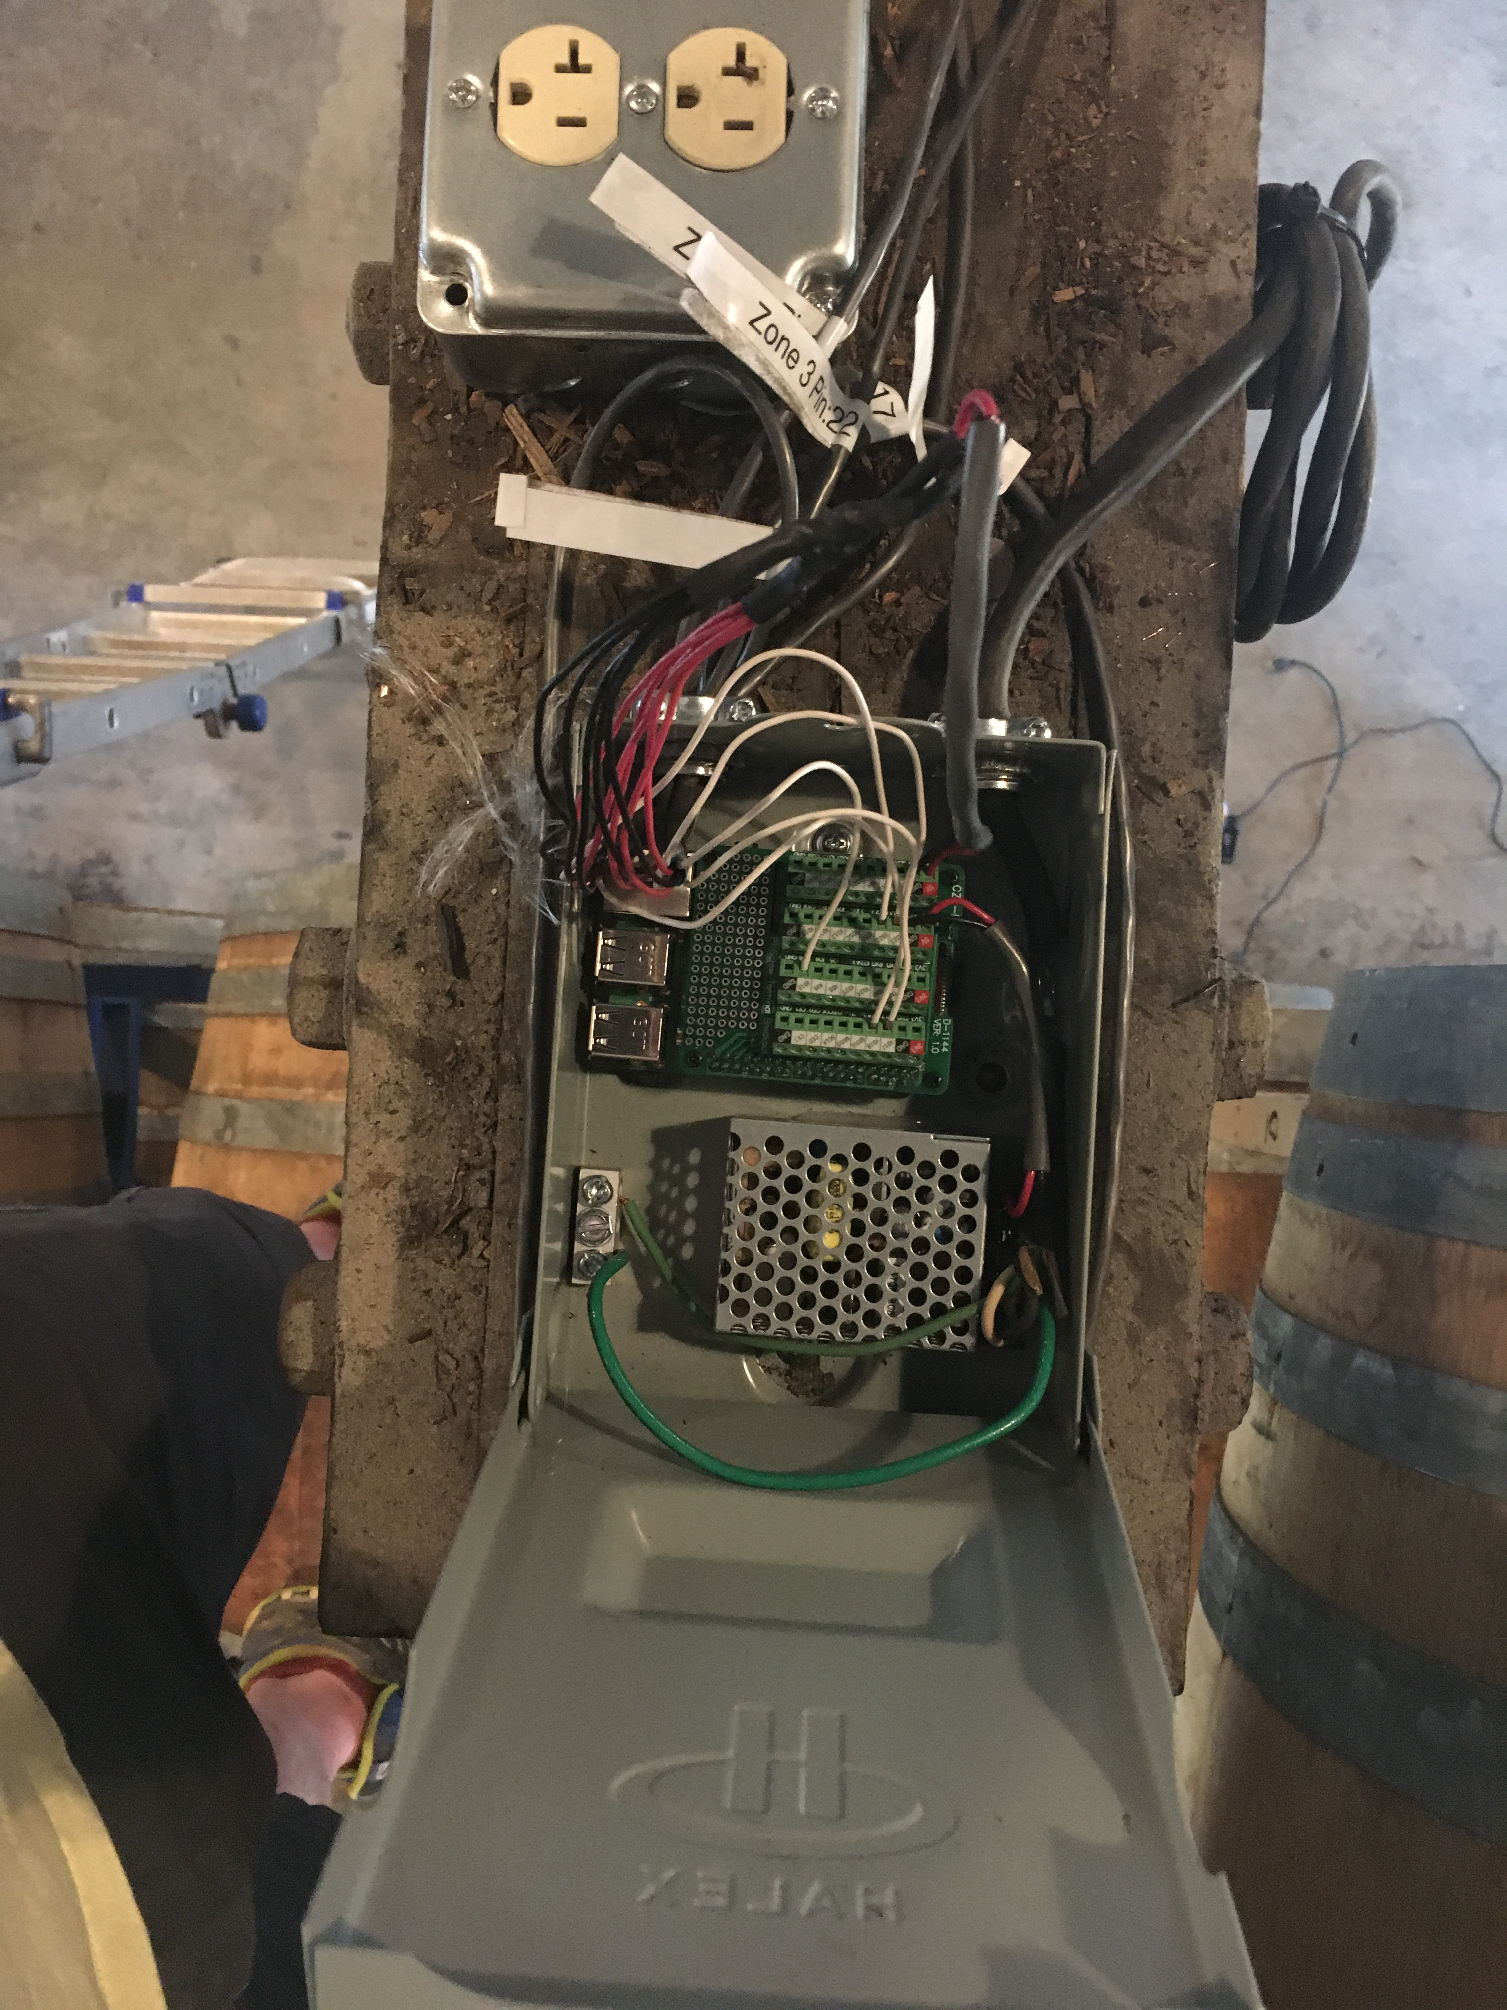
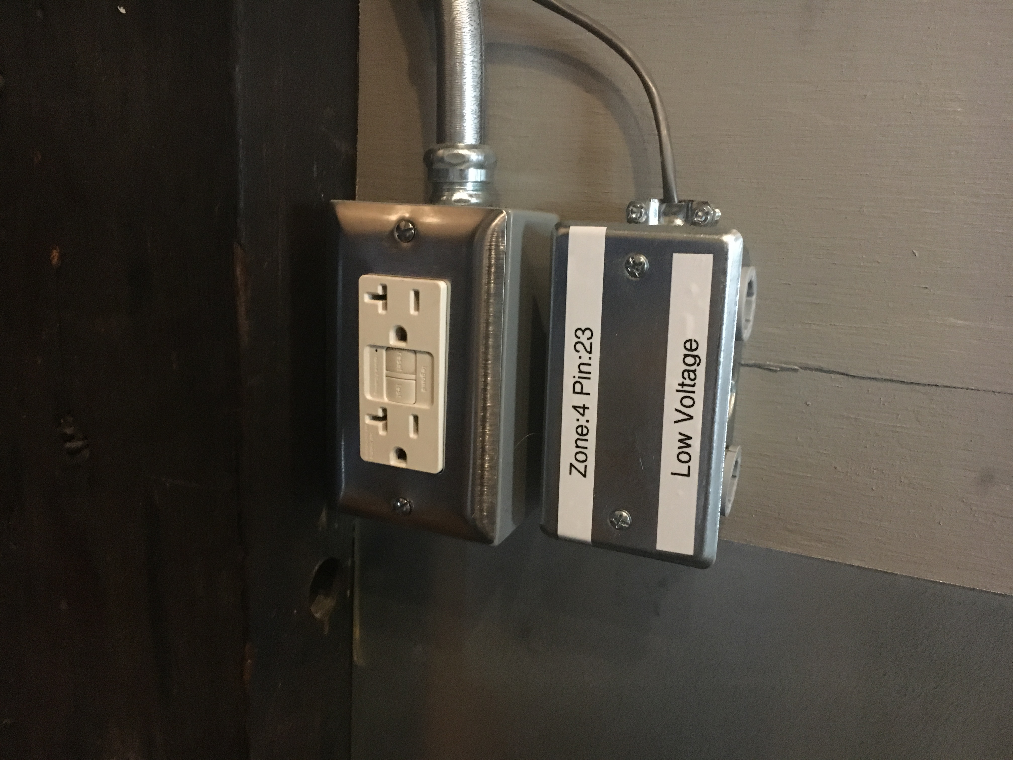

Slide 23
Hardware 2.0
(another) Raspberry Pi 3
(another) Mean Well RS-15-5 5V 3 Amp 15W
5@ HiLetgo DHT-22 / AM2302
(another)AC disconnect box from H.D.
Handy boxes from H.D.
4 sticks of hot glue
Electronics-Salon Pi Screw Terminal Block

Slide 25
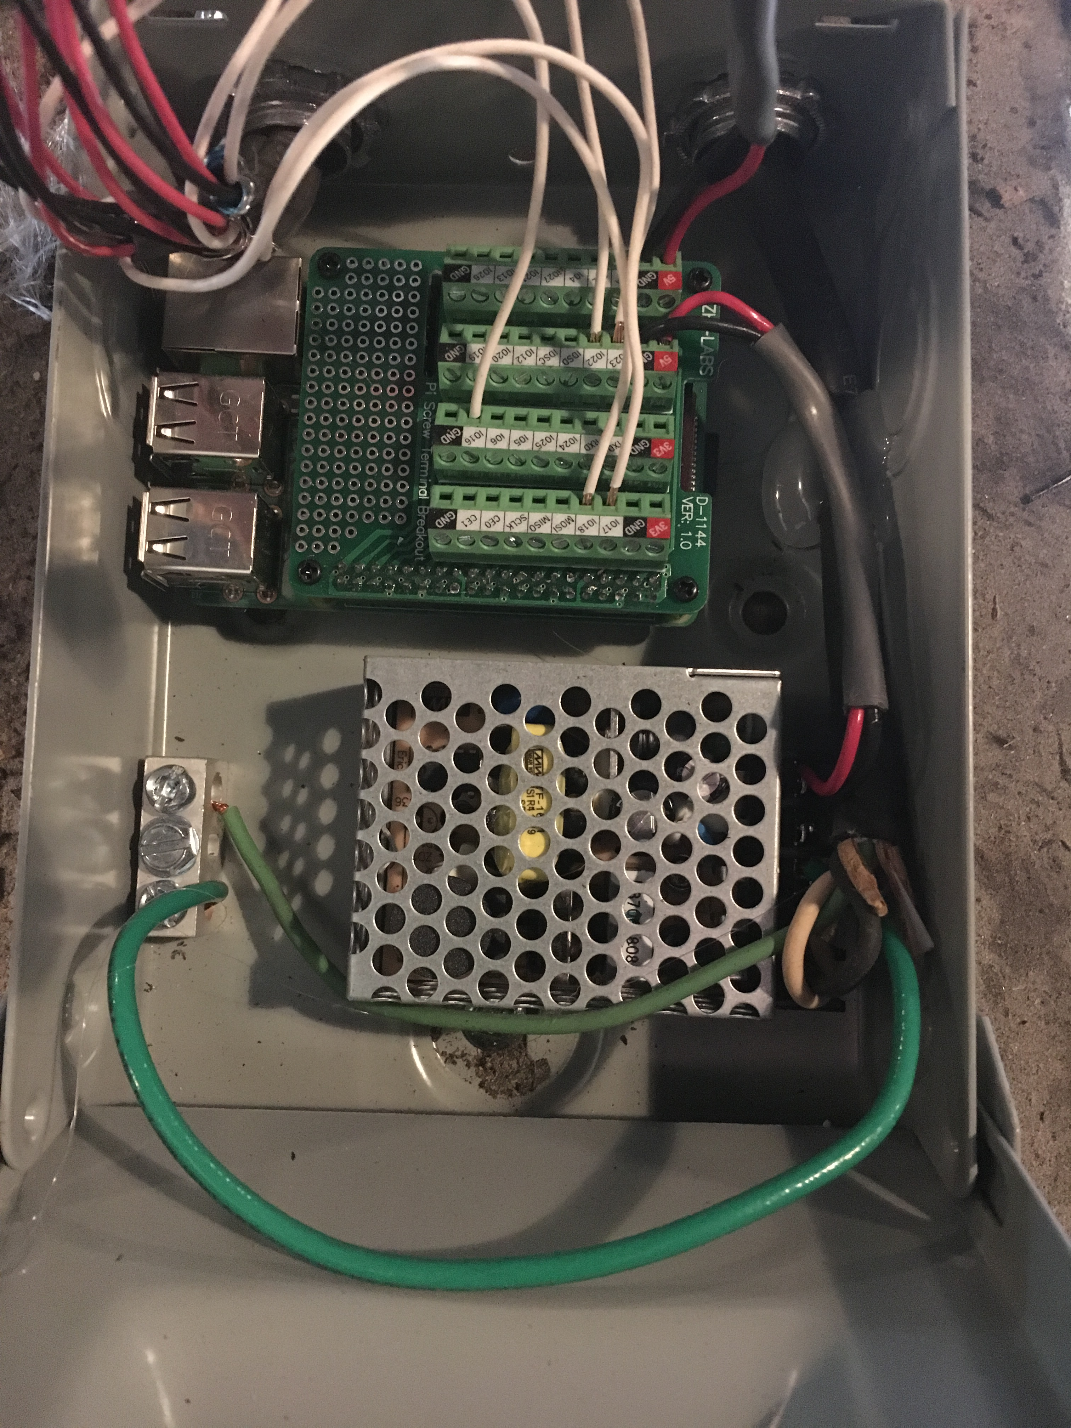

Slide 26
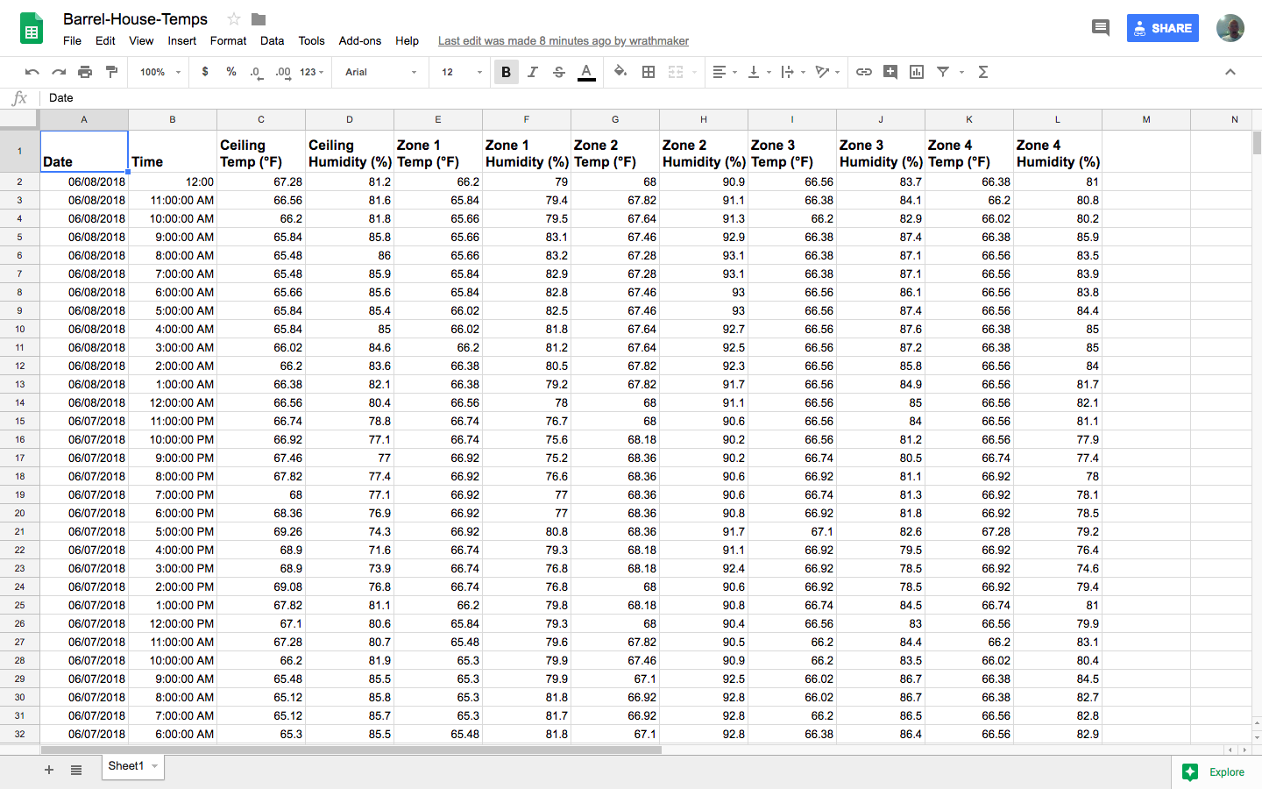

Slide 27
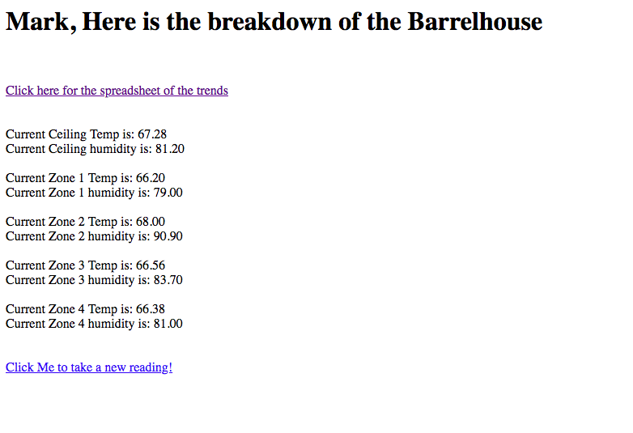

Slide 28
Software 2.0
Cron > spreadsheet.py > tempfiles
Cron > checktemps.py > tempfiles
Apache / PHP < tempfiles

Slide 29
So What’s next?
More monitoring
Hydration support
More remote interfaces
Eye Candy

Slide 30
Ask me anything daddy

Slide 31
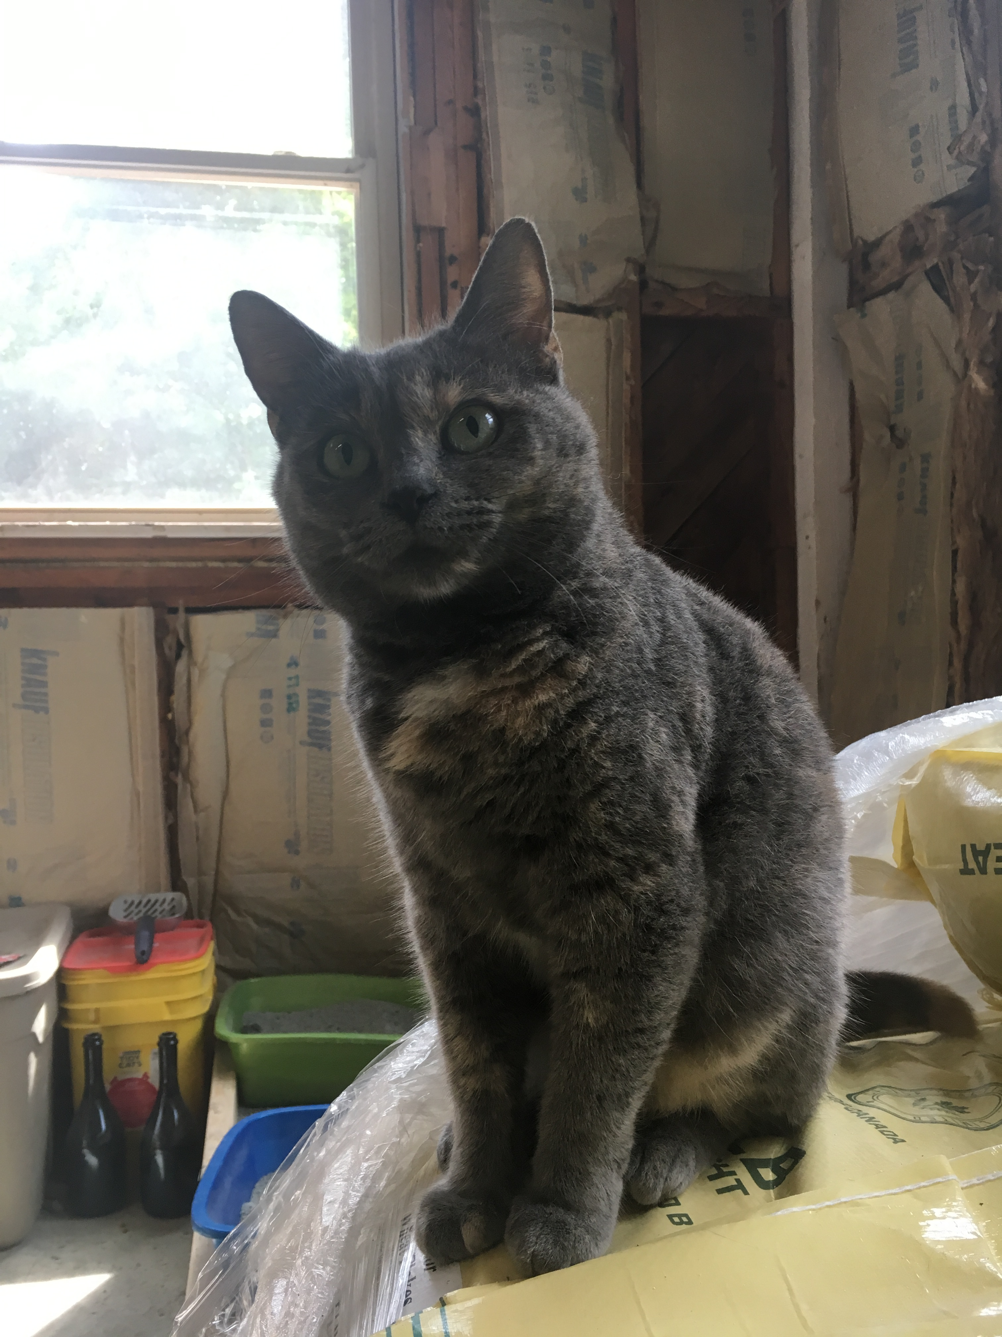
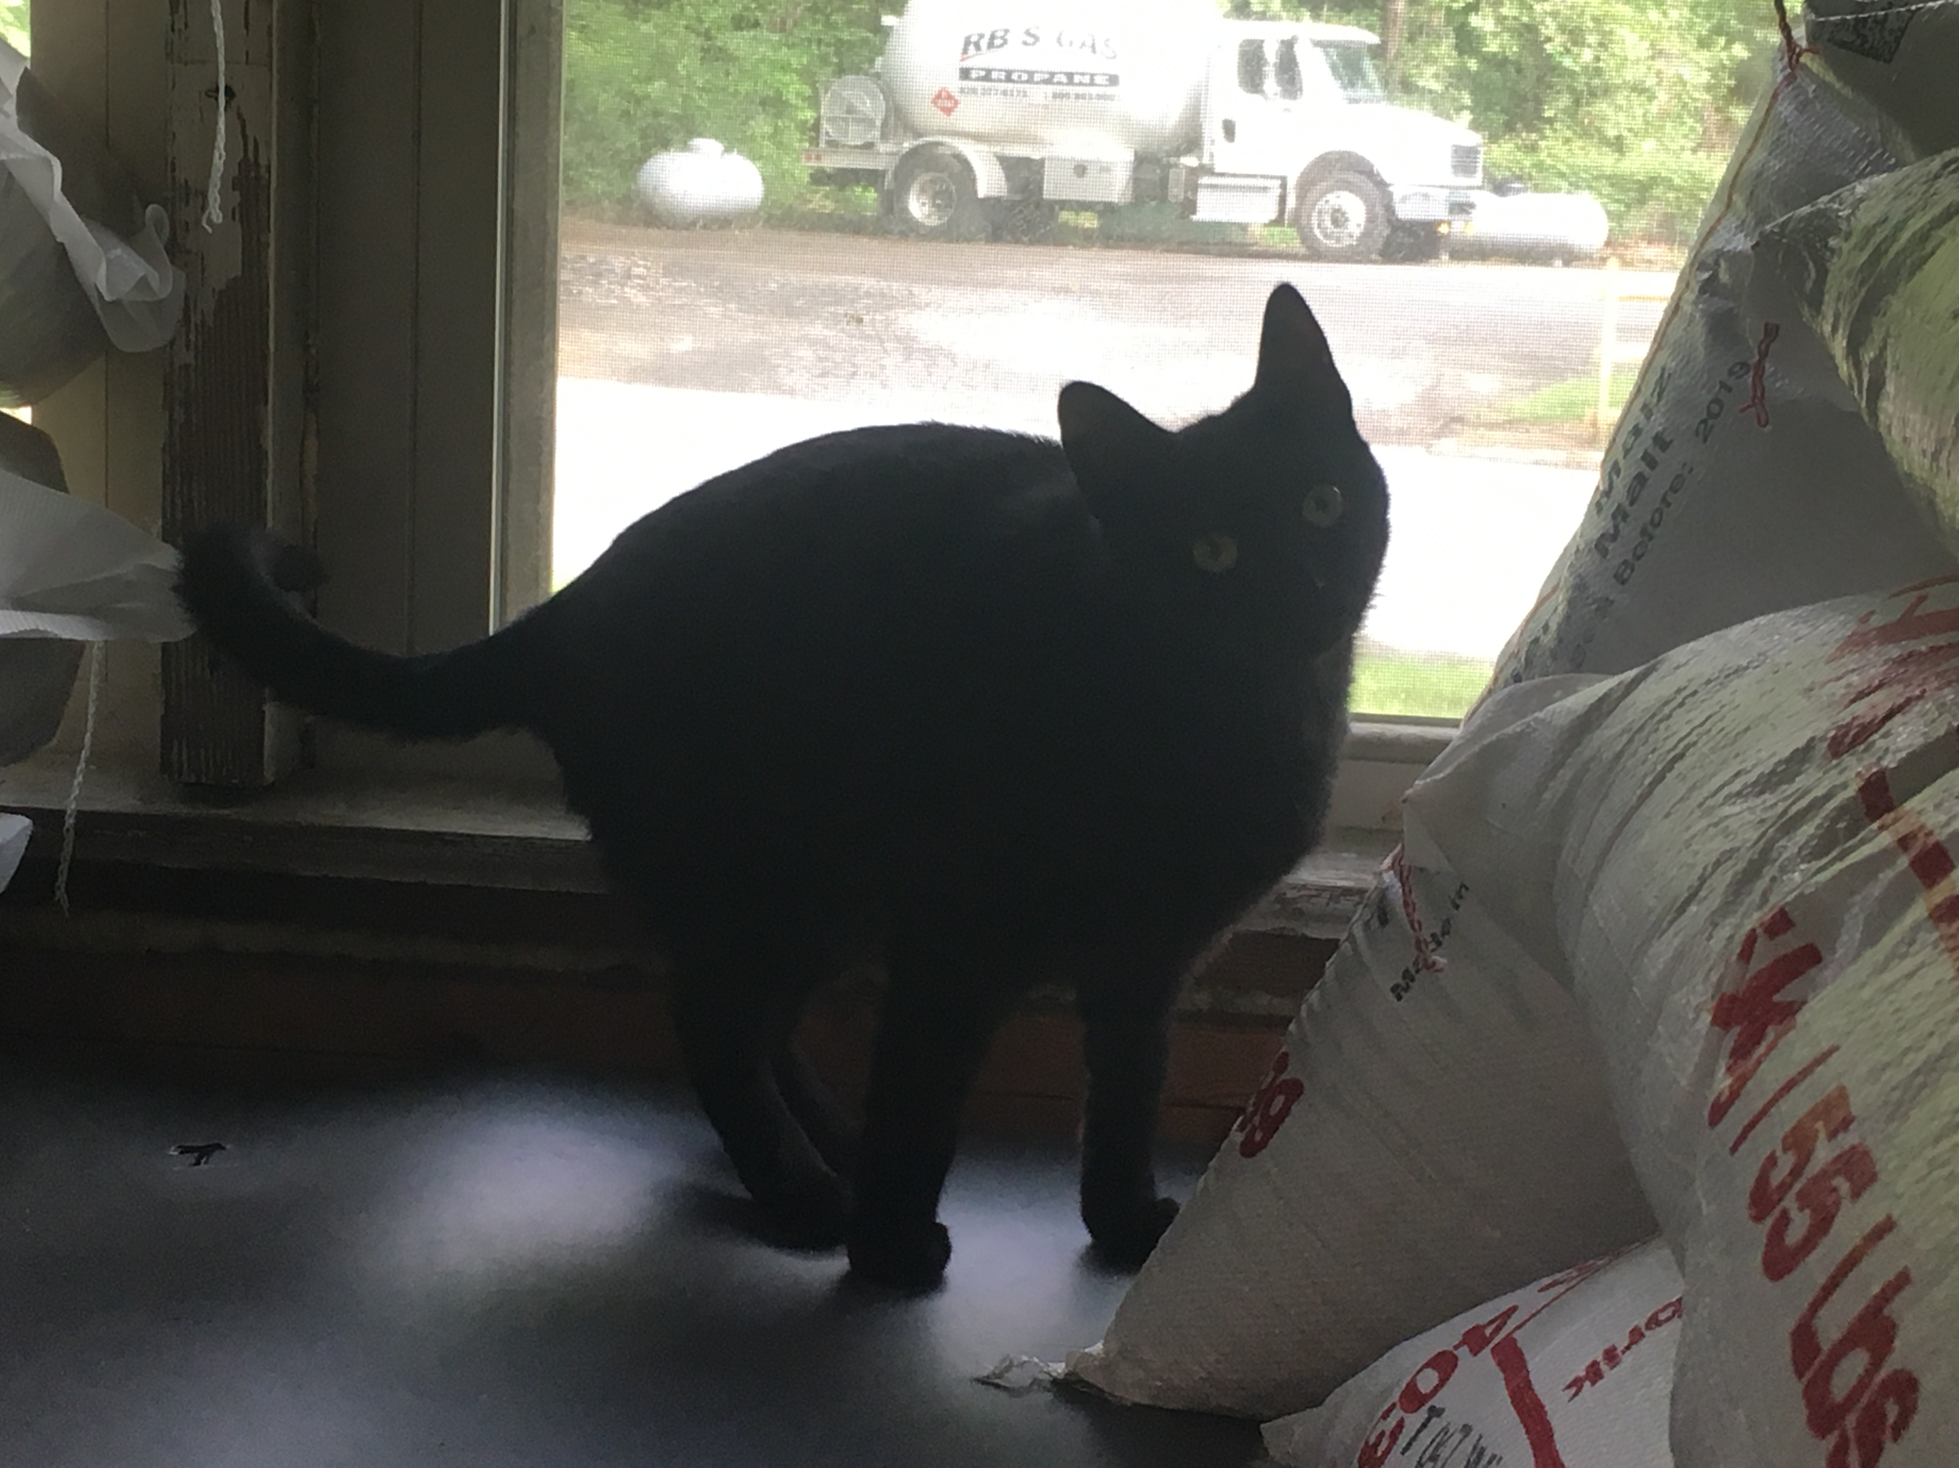

Get a hold of me
https://github.com/super-nathan
nathan@burialbeer.com

